Slide 1
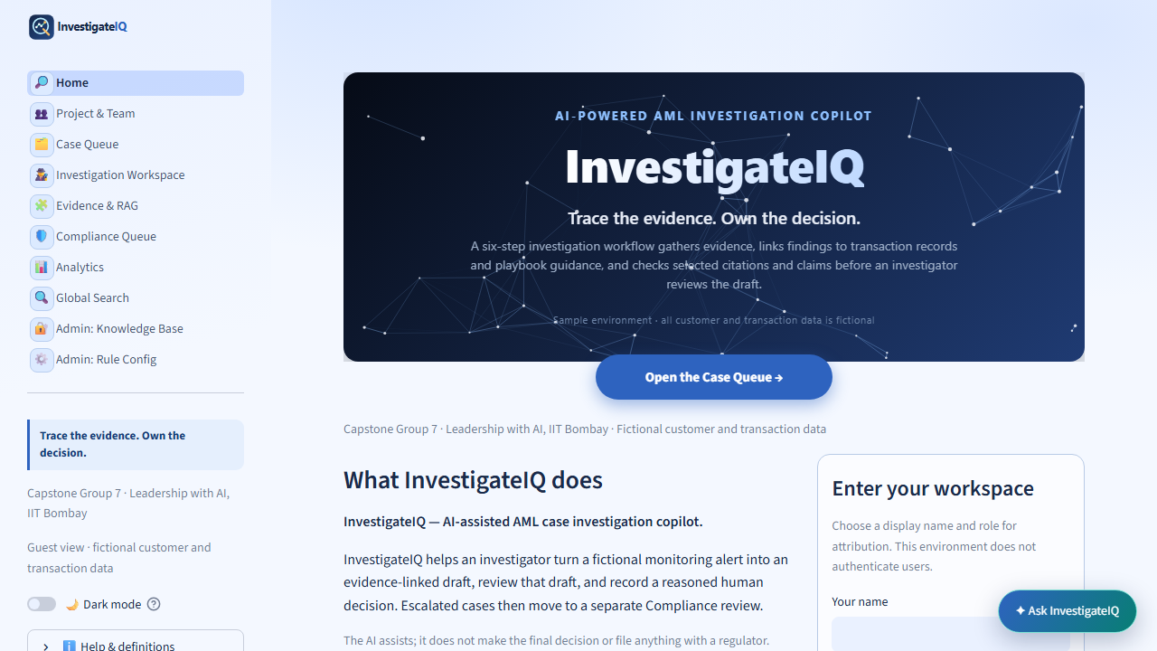
CAPSTONE GROUP 7
InvestigateIQ
Trace the evidence. Own the decision.
A transparent, AI-assisted workflow for fictional AML case investigations.
Soumya — presenter | Laxman — backup
5:35 core slides • live demo and questions within the 15-minute session
InvestigateIQ | Capstone Group 7 | 1 of 12
Fictional AML investigation learning environment
Notes:
Soumya opens in 25 seconds. State that this is a fictional AML learning product. The deck uses 5 minutes 35 seconds, then the demo and questions share the remainder of the 15-minute session; FAQ slides are appendix material only when asked.

Slide 2
PROGRAM STATEMENT
What this capstone will deliver—and what it will not
Design and demonstrate a fictional AML review workflow where every report claim is traceable to supplied material, limitations stay visible, and workflow actions remain named human decisions.
Track
Measures
Non-goals
Blueprint + Prototype + Detailed code + Final results
Traceability, visible gaps, clear states, and required rationale
No real data, autonomous decision, legal conclusion, or external filing
Team: Rahul Chainani · Pankaj Bharsakale · Lakshmi Dudgikar · Rahul Sharma · Laxman Singh · Soumya · Sweta Singh
Soumya presents the session; Laxman is the backup presenter.
InvestigateIQ | Capstone Group 7 | 2 of 12
Fictional AML investigation learning environment
Notes:
Soumya uses 35 seconds. Read the statement, selected track, and non-goals. Introduce the team in the displayed order and say that Soumya presents while Laxman is the backup.

Slide 3
THE PRODUCT
From a stored alert to an accountable human action
1
2
3
4
5
Queue
Workspace
Evidence
Decision
Compliance
Find and filter the fictional alert
Build or replay the review
Read exact records and chunks
Record a required rationale
Perform a second human review
The application supports investigation. It never closes, escalates, refers, or files an action automatically.
InvestigateIQ | Capstone Group 7 | 3 of 12
Fictional AML investigation learning environment
Notes:
Soumya uses 30 seconds. Move left to right through the flow. Emphasize human decision ownership and separate Compliance review.

Slide 4
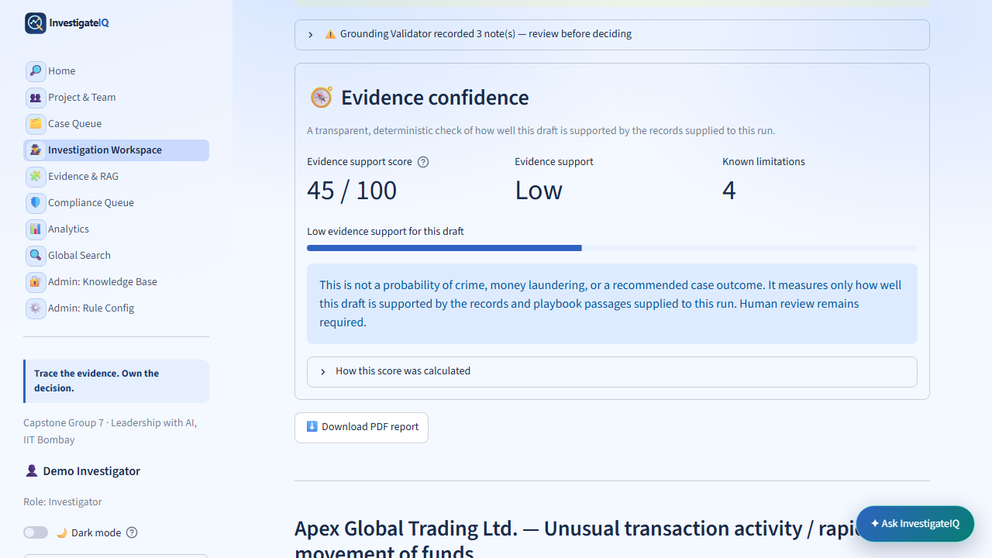
RESPONSIBLE AI
Evidence confidence exposes support gaps—it does not predict wrongdoing
Coverage
Supplied records and guidance that support the draft
Limitations
Known missing or unresolved evidence
Boundary
Not a crime, legality, or outcome probability
InvestigateIQ | Capstone Group 7 | 4 of 12
Fictional AML investigation learning environment
Notes:
Soumya uses 40 seconds. Define evidence confidence as deterministic support coverage. It is not a risk score, probability of crime, legality assessment, or recommended outcome.

Slide 5
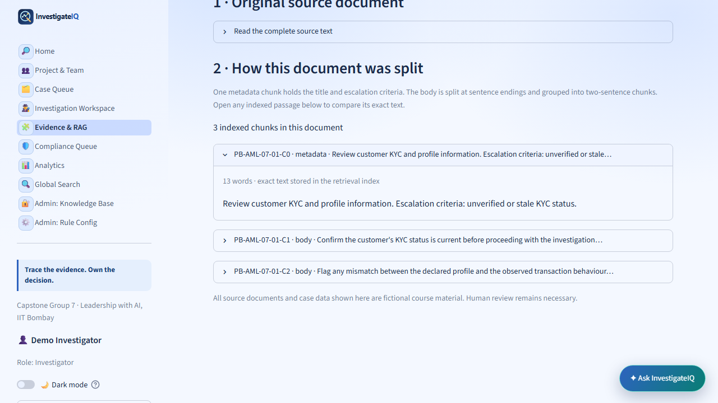
OKF, CHUNKS, AND RAG
The coding logic keeps the source trail inspectable
1
OKF source
ID, scenario, title, criteria, body
2
Chunk builder
C0 metadata + two-sentence body chunks
3
FTS5 + BM25
Local keyword match and rank
4
RAG context
Retrieved IDs produce a cited, reviewable answer
OKF source → chunk builder → FTS5/BM25 → retrieved IDs → cited response
InvestigateIQ | Capstone Group 7 | 5 of 12
Fictional AML investigation learning environment
Notes:
Soumya uses 55 seconds. OKF is Open Knowledge Format: a source record with stable metadata and body text. Explain C0 metadata and two-sentence chunks, then local SQLite FTS5 keyword search and BM25 ranking. Say retrieval finds text; it does not prove truth.

Slide 6
ARCHITECTURE: TECHNOLOGY, AI, AND GUARDRAILS
Six specialist components, one optional model draft, and a human decision
1
2
3
4
5
Fictional data + index
Specialist workflow
Summary draft
Grounding Validator
Human + audit
SQLite case rows, OKF guidance, exact chunks, FTS5/BM25
Triage · Customer/KYC · Transactions · Relationships · Evidence
Investigation Summary Agent; optional Gemini call or calculated mode
Checks cited IDs, selected ratios, forbidden verdict wording, prompt-like text
Named rationale; append-only audit event; separate Compliance review
Where AI is used: the Investigation Summary Agent drafts a structured report only after the deterministic specialist components retrieve and calculate evidence. The Grounding Validator then checks selected claims before a human can act.
Important: these are investigation-specialist components—not CEO/CFO persona agents. The validator reduces specific errors; it cannot guarantee factual truth.
InvestigateIQ | Capstone Group 7 | 6 of 12
Fictional AML investigation learning environment
Notes:
Soumya uses 55 seconds. Explain the flow left to right. The real implementation contains five evidence-gathering specialists plus an Investigation Summary Agent. Only the Summary Agent calls the optional Gemini model; calculated mode has no model call. The Grounding Validator checks known source IDs, selected ratio wording, forbidden verdict language, and obvious prompt-like source text. It reduces selected hallucination risks but cannot guarantee truth. Do not call these CEO or CFO agents.

Slide 7
LIVE DEMONSTRATION FLOW
Two cases: documented closure, then an open/escalated investigation
0:00–0:35
Case A — documented closure
From Queue, open Evidence only. Show why the closed outcome has recorded support; do not alter it.
0:35–1:15
Case B — open/escalated
Open the default review case; distinguish Status, Rule(s), and Action.
1:15–2:05
Workspace
Run saved/calculated review; show validator and evidence-confidence limitations.
2:05–2:55
Evidence & RAG
Open Source & chunks; explain FTS5/BM25 lexical retrieval—not vectors. Admin view is optional if already unlocked; never show the passcode.
2:55–3:40
Ask InvestigateIQ
Ask one bounded case question; show the response, citations, and limits.
3:40–4:50
Human decision / audit
Show Close, Request more information, and Escalate options plus required rationale; do not submit or close any case.
InvestigateIQ | Capstone Group 7 | 7 of 12
Fictional AML investigation learning environment
Notes:
Soumya uses 45 seconds to explain the demo plan, then performs it. Start with a documented closed case to show evidence access, then use the open/escalated case for the investigation. Do not submit an investigator or Compliance action, create intake data, reset decisions, or reveal an Admin passcode. Speak only about what is under the pointer.

Slide 8
VALUE REALIZATION AND ROADMAP
Measure the benefit before claiming ROI
Efficiency
Verified minutes saved locating case records and source passages
Rework
Avoided evidence requests and Compliance returns
Audit readiness
Time to reconstruct evidence, rationale, and outcome
Safety
Unsupported claims, broken citations, unclear states found in review
ROI % = (verified annual benefit − implementation and run cost) ÷ implementation and run cost × 100
Roadmap: test fixtures + citation evaluation → authentication + lineage versioning → governed ingestion + approved integrations
Planning model only: calculate ROI only after a baseline, approved cost boundary, and verified pilot outcomes.
InvestigateIQ | Capstone Group 7 | 8 of 12
Fictional AML investigation learning environment
Notes:
Soumya uses 50 seconds. Say this is an ROI measurement framework, not an invented financial result. Name the four value levers and future sequence. A real ROI needs a baseline, approved costs, and verified pilot results.

Slide 9
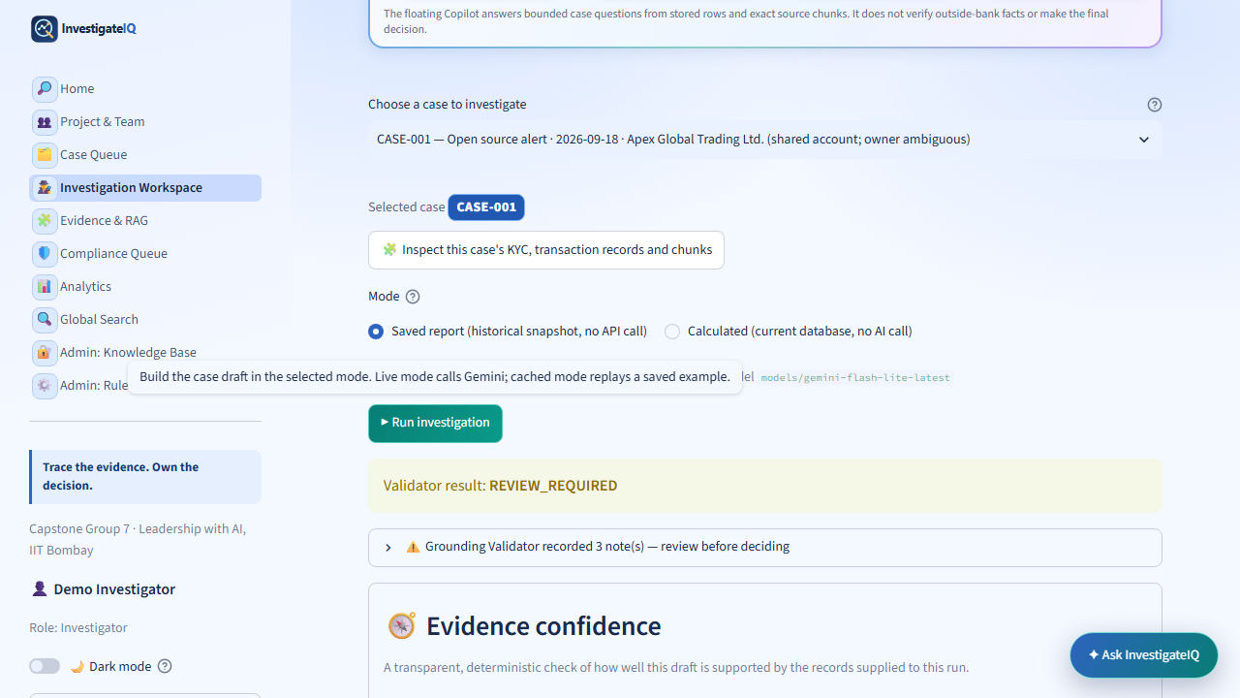
THANK YOU
Trace the evidence. Own the decision.
Traceable evidence
Records, chunks, citations, and visible gaps
Responsible AI
Confidence limitations, not automated judgement
Human accountability
Named rationale and separate Compliance review
Thank you. The FAQ appendix is available for any follow-up question.
InvestigateIQ | Capstone Group 7 | 9 of 12
Fictional AML investigation learning environment
Notes:
Show this slide after the live demo. Soumya closes in 15 seconds and uses the FAQ appendix only if a relevant question is asked. Questions, demo, and slides all fit within the 15-minute session; no separate Q&A allocation is assumed.

Slide 10
FAQ APPENDIX 1
Where does the data come from, and how is it relevant?
What is the data source?
All cases, customers, transactions, documents, and guidance are fictional course material stored locally for this demonstration. The product is not connected to a bank feed or real customer records.
How is retrieval relevant to a case?
The active case/scenario scopes the available evidence. SQLite FTS5 performs lexical keyword matching and BM25 ranks matching passages. The user can open the exact record or chunk behind a result.
Does a citation prove a claim?
No. It is a pointer to inspect supplied text. The product labels evidence gaps and requires a human to interpret the material and record the next action.
InvestigateIQ | Capstone Group 7 | 10 of 12
Fictional AML investigation learning environment
Notes:
Appendix only—do not present unless asked. Soumya can state: the data is fictional; retrieval is lexical FTS5/BM25 over scoped local text; citations are review pointers, not proof.

Slide 11
FAQ APPENDIX 2
Where is AI used, and how do we reduce hallucination risk?
Where is AI used?
Five specialist components collect/compute evidence. The Investigation Summary Agent is the only component that makes an optional Gemini model call; calculated mode makes no model call.
What guardrails exist?
Prompt rules require cited source IDs, avoid verdict language, and treat source fields as untrusted. The validator checks selected citations, ratios, and unsupported conclusion wording.
Can the system guarantee truth?
No. These checks reduce specific failure modes only. Evidence confidence exposes limitations, and a named human—not the AI—decides whether to close, request information, or escalate.
InvestigateIQ | Capstone Group 7 | 11 of 12
Fictional AML investigation learning environment
Notes:
Appendix only—do not present unless asked. Do not say the validator eliminates hallucination. Say it reduces specific risks and cannot guarantee factual truth.

Slide 12
FAQ APPENDIX 3
How are access, audit, and value handled?
Is this role-based access control?
No. The visible role selector is a demo display label. Admin pages use a limited passcode gate, which is not production authentication or authorization; the code is not shown in the deck or Blueprint.
What is in the audit trail?
System, AI, and human workflow events are recorded with case context. A human decision requires a name and rationale and becomes a recorded state; a Compliance return creates a new auditable step.
How much money or time does it save?
No percentage or financial claim is made from fictional data. A real pilot would measure verified lookup time, rework, audit reconstruction time, and safety issues against an approved cost baseline.
InvestigateIQ | Capstone Group 7 | 12 of 12
Fictional AML investigation learning environment
Notes:
Appendix only—do not present unless asked. State clearly that the Admin passcode is not disclosed, the demo is not RBAC, and ROI is a pilot measurement framework rather than a financial result.

